Slide 1

SmartPlant 3D Programming
Naming and Interference Rules
TSMP4005
Jim Hanson
Intergraph Corporation

Slide 2
Agenda
  Day 1-2
    SP3D Overview
      Business Objects/ Persistent Data
      Schema Browser Tool
      - Discuss Business object provided by System and Specification Task
      Classes, Interfaces and Properties
      Equipment and Piping Data Model
      - Discuss Business object provided by Equipment and Piping Applications
      - Discuss the relationships of the business objects
    Naming Rule
      Creation
      Naming Rule Model
      Attribute, Relation, Naming Counter Services

Slide 3
Agenda
  Day 2-3
    Interference checking service
      Overview
      Interference Entity Data Model
      Processing Rules
      - Suppress interference between objects imported from CIMSteel
      - Assign a proper permission group for the interference object
      - Assign proper status for the interference object based on the interference type
      - Don’t report Insulation and insulation interferences when 2 pipes are connected by a component 2-3

Slide 4
Overview
  Site Database: Persistent site data (location, model name, catalog name)
  Model Database: Persistent model data
  Catalog Database: Persistent reference data (specifications, parts)
  Report Database : Provides access to persistent data through a logical schema (view tables)
  handles/hides the mechanism to connect all data stores
Third party Application
SQL query
Report Database Set
Model Database
Site Database set
Catalog Database set

Slide 5
Overview
Business Objects (BO’s)
  Business objects are COM objects designed to represent the various elements of the design model (Example: pipes, valves, etc..)
  Business objects exist only in the Middle Tier and only for the lifetime of a transaction.
Roles
To be part of SmartPlant 3D framework, a business object must support specific roles by implementing one or more interfaces. These roles are:
  Geometric - Has 3D geometries.
  Persistent - Can be saved and restored.
  Displayable - Can be viewed in the Client tier.
  Relationship-enabled - Participates in relationships.
  User attributes-enabled – Can add user attributes

Slide 6
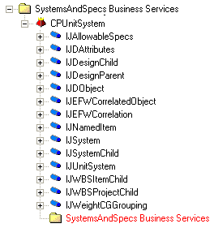
SmartPlant 3D Data Model
Use the Schema Browser Tool to view the data model
Model Database
Catalog Database
Catalog Schema Database

Slide 7
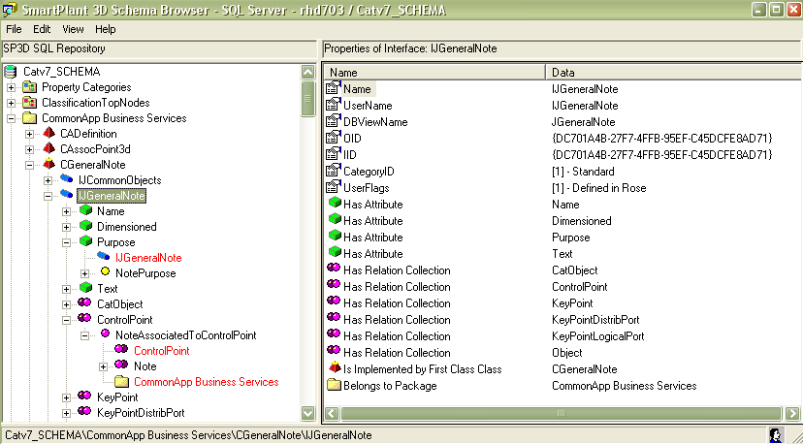
Schema Browser Tool
Metadata Object highlighted in the treeview or found by Find
Package
Class
Interface
Property
Metadata Object Properties
Codelist
Metadata Object Relationship
Relation Collection
Relation
Ancestor

Slide 8
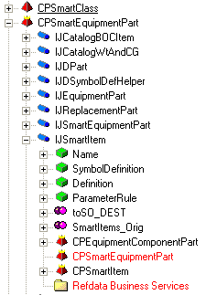
Schema Browser Tool
A regular folder represents a package i.e. metadata of a service
A red pyramid represents a class. A red pyramid overlayed by a yellow crown represents a first class, i.e. a class that is a leaf in the BOC (Business Objects Classification) hierarchy
A blue cylinder represents a interface
A green box represents a property.
Defining interface

Slide 9
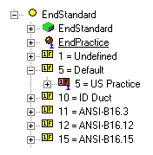
Schema Browser Tool
A yellow sphere represents a codelist table.
A yellow domino with a number and a letter represents a codelist value.
A brown sphere overlayed by a blue human outline represents a parent codelist table.
A brown domino with a number and a letter overlayed by a blue human outline represents a parent codelist value.

Slide 10
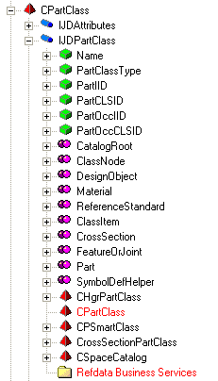
Part Class Entity Data Model
Part Classes
Class
Interface
Notes:
select count(*),
PartClassType
from JDPartClass
group by PartClassType
select * from
JDPartClass
where PartClassType = 'EquipmentAssemblyClass'

Slide 11
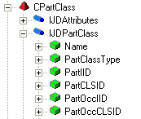

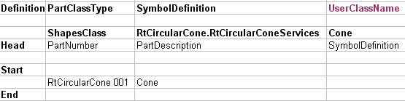
Part Classes Type (Shapes Class)
Model DB
Catalog DB
.xls
Bulk-load
Part
Occurrence A1
Madefrom
Class
Part
Occurrence A2
Part1
Part2
Symbol
Code
Symbol
Definition

Slide 12
SQL Basics
Relational Databases are made of:
  Tables
    Where the data are persisted. Tables are made of columns (the properties) and rows (the occurrences or records).
  Views
    A predefined selection of a subset (or a superset) of columns and/or a subset of rows from one or more table(s).
  Relations
    They are not “hard-coded”, they are established on request by performing a join (usually equality of values of identical columns of different tables).

Slide 13
SQL Basics
Query Language
SELECT t1.col1, t2.col2
FROM t1 JOIN t2 ON (t1.col2 = t2.col4)
WHERE t1.col1>200
ORDER by t1.col1
  SELECT: means list, return, give me…
    List of columns from which data must to be listed. It defines a subset of the columns to be returned. * means All.
  FROM: defines the view (or starting point view) from which the columns and data must be listed. If a join is specified, a superset of the columns of the view is accessible.
    JOIN: the way to navigate relations, defines a second view to be joined.
      ON: specifies the condition of the join.
  WHERE: criteria to establish a filter (subset) of the rows to be listed
  ORDER BY: sorting criteria

Slide 14
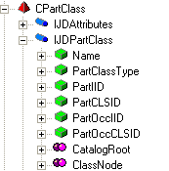
Part Class Entity Data Model
Part Classes
select count(*),
PartClassType
from JDPartClass
group by PartClassType
select * from
JDPartClass
where PartClassType = 'EquipmentAssemblyClass'
Notes:
select count(*),
PartClassType
from JDPartClass
group by PartClassType
select * from
JDPartClass
where PartClassType = 'EquipmentAssemblyClass'

Slide 15
Lab 1
Create a query that returns all part classes of type ShapeClass defined in the catalog DB

Slide 16
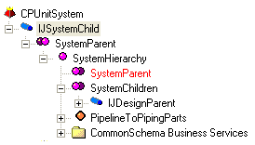
Schema Browser Tool
Relationships
  are the SmartPlant 3D business rules
  define how BO's Behave with respect to each other
  react to changes as they take place, ensuring data consistency
  A relation is between two and only two business objects (entities)
  These entities are known as origin and destination of the relation.
Unit System
Relation Collection
Piping System
Relation
Relation Collection

Slide 17

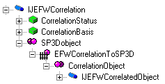

Schema Browser Tool
A single magenta sphere represents a relationship. A single magenta sphere overlayed by a fence represents a private relationship.
Double magenta/purple spheres represent a relationship collection (a role).
An orange diamond represents an Edge, i.e a virtual relationship that "bridges" several relationships.
Double Orange diamonds represent an edge collection (a role).

Slide 18

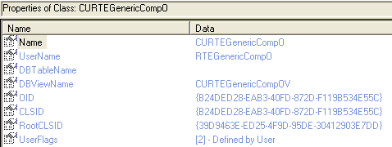
Schema Browser Tool
Metadata object marked as deleted.

Slide 19
Schema Browser Tool
Under View -> Units of measure, you can see the units for each Unit type. For each Unit type, the blue unit represents the (SI) Database unit (DBU). Right click on any unit allow you to convert a value in DBU.
Under view -> Enumerations, you can know the different values of all the enumerations used by the metadata.
If you re-open often the same schema, you should choose "Auto open open DB dialog" in Options.
You can switch from displaying metadata object internal Names (System) to Usernames (User).

Slide 20
System Entity Data Model
COM Classes and Interfaces
Package
Class
Interface

Slide 21
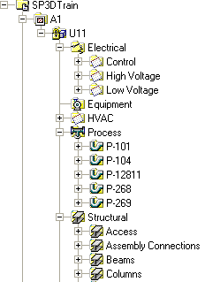
System Entity Data Model
Business Objects Defined in Systems And Specifications Application
The system hierarchy is a functional breakdown of the model (Plant/Ship) and is intended for design data management purposes.
CPAreaSystem - Area System
CPUnitSystem - Unit System
CPMSystem - Generic System
CPMachinerySystem - Equipment System
CPPipingSystem - Piping System
CPPipelineSystem - Pipeline System
CPStructuralSystem - Structural System
CPElectricalSystem - Electrical System
CPConduitSystem - Conduit System
CPDuctingSystem - HVAC System

Slide 22
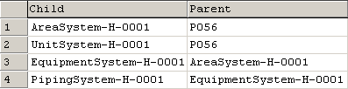

System Entity Data Model
SQL Example: List the child-parent names
Select x3.ItemName as Child, x5.ItemName as Parent
from JAllowableSpecs x1
JOIN JNamedItem x3 on x3.oid = x1.oid
JOIN XSystemHierarchy x4 on x4.oidDestination = x1.oid
JOIN JNamedItem x5 on x5.oid = x4.oidOrigin

Slide 23
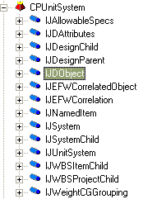
System Entity Data Model
Supported interfaces
IJDObject interface is a required interface for almost all objects and supports access control.
IJNamedItem interface provides the name property for all named objects.
IJDAttributes interface is required for the system object to support user-defined attributes.

Slide 24
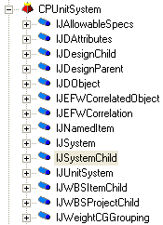
System Entity Data Model
Supported interfaces
IJSystemChild: Any entity that appears in the System Hierarchy and is capable of being a child of a system will implement this interface.
IJAllowableSpecs: This interface is required in order to associate the system object to a collection of allowable specs.
IJEFWCorrelation and IJEFWCorrelatedObject: This interface is required in order to associate the system object to the Engineering Framework Design Basis object and provides the EFW Correlation Properties.
IJWeightCGGrouping :This IJWeightCGGrouping interface is to manage the weight and center of gravity (Weight&CG) for objects that represent logical groups of parts such as a system, an assembly, or a compartment.

Slide 25
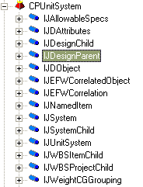
System Entity Data Model
Supported interfaces
IJSystem: This interface is used to provide a common interface for system objects.
IJDesignParent and IJDesignChild:
  An object in the system hierarchy that can have children must implement the IJDesignParent interface.
  An object that can be the child of a parent must implement the IJDesignChild interface.
IJWBSItemChild and IJWBSProjectChild:
  An object in the workbreakdown structure hierarchy that can be the child of a parent must implement these interfaces.

Slide 26
System Entity Data Model
Use of Relationship
Business objects must play many roles (Example: Relationship enable) by implementing one or more interfaces.
  IJSystemChild: The interface destination of the relationship
  IJDesignParent: The interface origin of the relationship
  A relationship type (Applications define typed relationships)
Relation Collection
Relation
Relation Collection

Slide 27
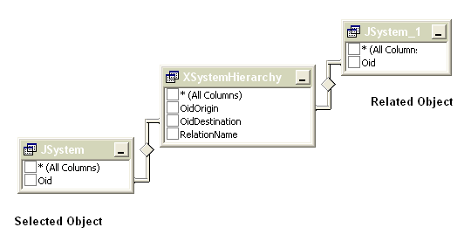
System Entity Data Model
Accessing Relationships from SQL
A relationship can be navigated; and the destination object can be retrieved by knowing the object identifier and the view relation table.

Slide 28
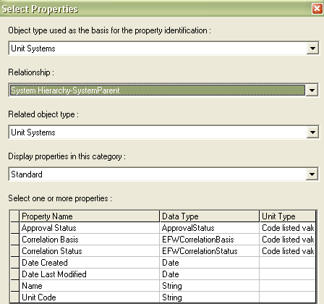
System Entity Data Model
Accessing Relationships from COM+
Graphical User Interface
Provide access to properties of related objects

Slide 29
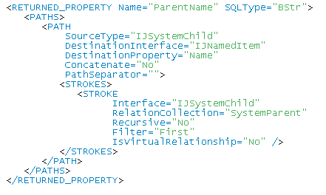
System Entity Data Model
Accessing Relationships from COM+
Label Editor generates XML files
Use XML tags to access to related objects

Slide 30
System Entity Data Model
Accessing Relationships from Visual Basic
Relation Helper Service
  Provides access to related objects
  To use this service you must know the relation collection name and the interface name
Interface name: IJSystemChild
Relation collection name: SystemParent
CollectionRelations(interfaceID, collectionName As String) As Object

Slide 31
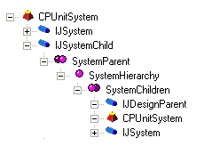
System Entity Data Model
Accessing relationships from Visual Basic
Example:
Dim oRelationHelper As IMSRelation.DRelationHelper
Dim oCollection As IMSRelation.DCollectionHelper
Set oRelationHelper = oObject
Set oCollection = oRelationHelper.CollectionRelations("IJSystemChild", "SystemParent")
Set oSystem = oCollection.Item(1)
Interface
Relation Collection
Related Object

Slide 32
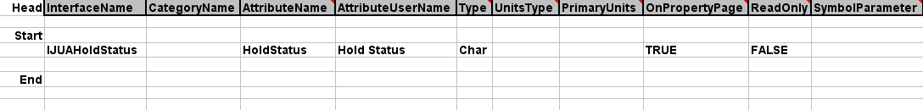
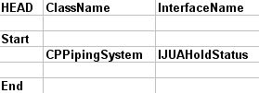

System Entity Data Model
Interfaces and Properties
  User attributes are tied to interfaces
  User can extent the data model by adding custom interfaces and properties.
Custom Interface sheet
CustomClassInterfaceList sheet

Slide 33
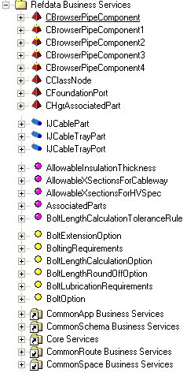
Reference Data Model
Package
Class Business Objects
Interface
Relation
Codelist
Dependencies
Dependencies

Slide 34
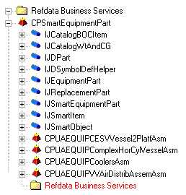
Equipment Reference Entity Data Model
CPSmartEquipmentPart
Package
Class
Interface
Notes:
select
* from
JSmartEquipmentPart x1
join JSmartItem x2 on x2.oid = x1.oid
join JDSymbolDefHelper x3 on x3.oid = x1.oid
join JDReplacementPart x4 on x4.oid = x1.oid
join JEquipmentPart x5 on x5.oid = x1.oid
join JDPart x6 on x6.oid = x1.oid

Slide 35
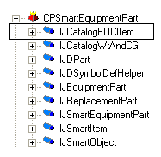
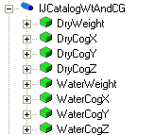
Equipment Reference Entity Data Model
Common interfaces
The IJCatalogBOCItem interface allows the Business Object to participate in the Catalog BOC (Business Objects Classification) hierarchy.
The IJCatalogWtAndCG interface provides methods to get the center of gravity and properties relating to an object's weight and center of gravity.

Slide 36
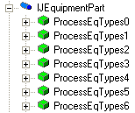

Equipment Reference Entity Data Model
Common interfaces
The IJEquipmentPart interface provides code-listed properties to describe the Equipment Classification Type for all equipment parts.
The IJReplacementPart interface provides a property to get the equipment part number when the mirror behavior option is set to Replacement required.

Slide 37
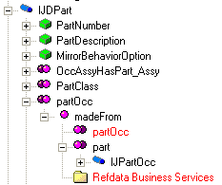
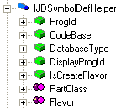
Equipment Reference Entity Data Model
Common interfaces
The IJDSymbolDefHelper interface provides methods to assists in the definition of the cached symbol and properties relating to the symbol definition.
The IJDPart interface is a generic interface that permits obtaining information about a part or part occurrence.

Slide 38
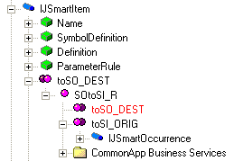
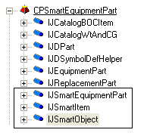
Equipment Reference Entity Data Model
Common interfaces
The IJSmartItem interface provides properties relating to the smart item and permits obtaining information about a smart item or smart occurrence. SOtoSI relationship.
The IJSmartObject interface permits obtaining information about a smart class.
The JSmartEquipmentPart interface provides methods to obtain information about Smart Equipment. Defining Interface

Slide 39
Lab 3
Create a query to list all smart equipment parts in the catalog DB. List their Name and PartDescription

Slide 40
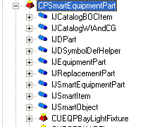



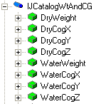
Equipment Reference Entity Data Model
Common Properties
Custom Properties
User Part Classes, Interfaces and Attributes
The Custom Interfaces sheet defines the customized user interfaces and attributes (properties) for the part classes.
Notes:
10
6

Slide 41
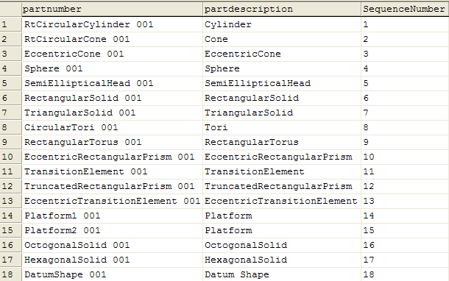
Equipment Reference Entity Data Model
(Equipment) Shapes
In the palette
select
partnumber,
partdescription,
SequenceNumber
from JDPart x1
join JUAPaletteInfo x2 on x2.oid = x1.oid
order by SequenceNumber
Notes:
select * from JDPart x1
join JUAPaletteInfo x2 on x2.oid = x1.oid
select
*
from
JDPart x1
join XPartClassContainsParts x2 on x2.oiddestination = x1.oid
join JDPartClass x3 on x3.oid = x2.oidorigin
where x3.PartClassType like '%SketchCrossSectionsClass%'

Slide 42
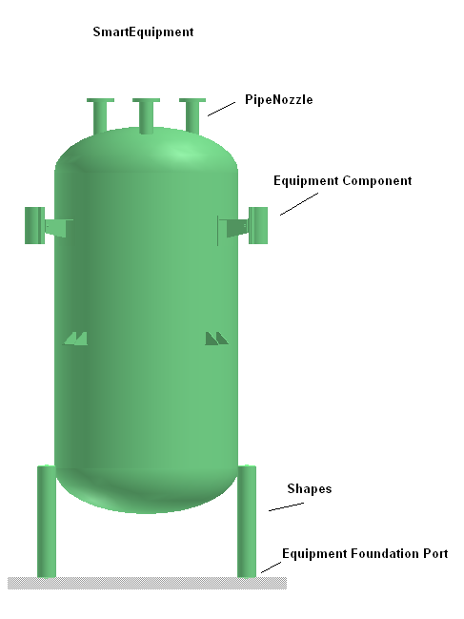
Equipment Data Model
Business Objects Defined in Equipment Application
  First Class Business Objects
  CPSmartEquipment
  CPEquipmentComponent
  CPShape
  CPPrismaticShape
  CPUAImportedShapeOcc
  CPPipeNozzle
  CPCableTrayNozzle
  CPConduitNozzle
  CPCableNozzle
  CPHvacNozzle
  CPEqpFoundationPort

Slide 43
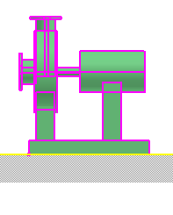
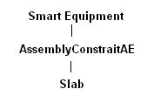
Equipment Data Model
Business Objects Defined in Equipment Application
  Non-First Class Business Objects
  CPAssemblyConstraintAE
  CPNozzleOrientation
  CPPipeNozzlePH
  CPCableTrayNozzlePH
  CPConduitNozzlePH
  CPCableNozzlePH
  CPHvacNozzlePH
  CPEqpFoundationPortPH
    Port Placeholder is a persistent object that holds the information about the actual port.

Slide 44
Equipment Data Model
MachinerySystem
Coordinate System
Smart Item
HasCSystem
HasEqpAsChild
SOtoSI_R
Smart Equipment
Occurrences
HasEqpComponents
<Pattern3MatePartRln>
Equipment Component
AssemblyConstraintAE
HasShapes
HasPorts
DistribPorts
Shapes
Pattern3MateSurfRln
Equipment Foundation Port
Route Ports
Surface

Slide 45
Lab 5
List all equipments in the model with their corresponding part name from the catalog DB

Slide 46
Piping Data Model
The routing model is specification driven
  It follows rules defined by the piping specifications.
  It uses predefined catalog parts from Reference Data to define the part occurrences
PipeRun
has features
Specification
Path
Feature
Generates Parts based upon
specifications and rules.
Part
Occurrence

Slide 47
Piping Data Model
Feature Based Model
A Path Feature provides Geometry:
  Path center line information: Start/End positions, Turns (Change of direction), etc
  InLine path Features have their centerline making up a PathLeg and provide flow.
  OffLine Path Features do not affect center line but may have AlongLeg behavior.
A Path Feature provides Connectability:
  Logically connect to equipment
  Branch from any feature
  Provide attachment connections to pipe supports.
A Path Feature provides Functionality:
  Capability to move geometry in 3D space with specific behaviors
  Generates part occurrences based on specifications

Slide 48
Piping Data Model
Piping System
SystemHierarchy
Pipeline
SystemsSpecs
Spec
SystemHierarchy
Distribution Connection
OwnsDistributionConnection
Piperun
PathRunUsesSpec
Spec
GeneratesConnectionItems
PathSpecification
Gasket/Bolt/Weld
Path Features
OwnsParts
PathGeneratedParts
ImpliedMatingPart
Part Occurrences
MadeFrom
Part
Gasket/Bolt Part
DistribPorts
RoutePipePort

Slide 49
Lab 6
List all Pipe Runs and their parent Pipelines in the model

Slide 50

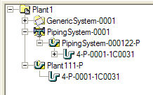
Piping Data Model
Example: returns pipe runs and pipeline names
select
x4.ItemName as PipeRunName,
x3.ItemName as Parent_System
from JRtePipeRun x1
join JNamedItem x4 on x4.oid = x1.oid
join XSystemHierarchy x2 on x2.oiddestination = x1.oid
join JNamedItem x3 on x3.oid = x2.oidorigin
Notes:
select
x4.ItemName as PipeRunName,
x3.ItemName as Parent_System
from JRtePipeRun x1
join JNamedItem x4 on x4.oid = x1.oid
join XSystemHierarchy x2 on x2.oiddestination = x1.oid
join JNamedItem x3 on x3.oid = x2.oidorigin

Slide 51
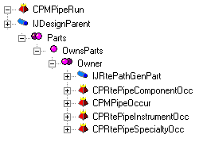
Piping Data Model
PipeRun and Parts Relationship
Owns Parts Relation
The OwnsParts relationship is used to specify that a part occurrence is a child of a run.
Relation Collection
Relation
Relation Collection

Slide 52
Lab 8
List all pipe component occurrences in the model DB per PipeRun. Give count of each type of component (same commodity code) per PipeRun

Slide 53
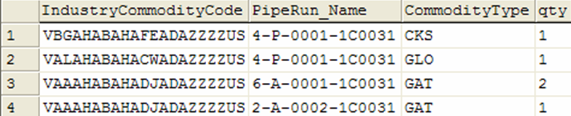
Piping Data Model
Example: Query all valves occurrences
Select
x3.IndustryCommodityCode,
x4.ShortStringValue as 'CommodityType',
count(*) as qty
from JRteCompOccur x1
Join XMadeFrom x2 ON (x2.OidOrigin = x1.Oid)
Join JDPipeComponent x3 ON (x3.Oid = x2.OidDestination)
Join CL_PipingCommodityType x4 ON (x4.ValueID = x3.CommodityType)
WHERE (x3.CommodityClass = 5)
Group by x3.IndustryCommodityCode, x4.ShortStringValue
Notes:
select
x3.IndustryCommodityCode,
x9.SpecName,
x10.ShortStringValue,
count(*) as qty
from JRteCompOccur x1
JOIN XMadeFrom x2 ON (x2.OidOrigin = x1.Oid)
JOIN JDPipeComponent x3 ON (x3.Oid = x2.OidDestination)
JOIN JDPipeComponent2 x4 ON (x4.Oid = x2.OidDestination)
JOIN CL_PipingCommodityType x10 on x10.ValueID = x3.CommodityType
JOIN XOwnsParts x5 ON (x5.oiddestination = x1.oid)
JOIN JRtePipeRun x6 on (x6.oid = x5.oidorigin)
JOIN XPathRunUsesSpec x7 ON (x7.OidOrigin = x6.oid)
JOIN JDSpec x8 ON (x8.oid = x7.oiddestination)
JOIN JDPipeSpec x9 on (x9.oid = x8.oid)
WHERE ( x3.CommodityClass = 5)
group by x3.IndustryCommodityCode, x9.SpecName, x10.ShortStringValue

Slide 54
Naming Rules
Customized component that allows users to define rules for formatting the names of business objects
Currently, the naming rule is a Visual Basic component
(Support of .NET will be in SP3D version 2008)
Name can be comprised of the following:
  Object type
  Object properties
  Primary organizational relationships
    System
    Space
    Assembly
    Work Breakdown
  Other relationships
    Connection

Slide 55
Naming Rules - Reference Data
Naming rules are associated to an object class
Multiple rules can be defined for each class of object
  If multiple rules are provided in the catalog, the user must select the rule to apply when objects are created
A rule can also be shared by multiple object classes
DefaultNameRule1
Object
DefaultNameRule2
Object
DefaultNameRule3
Object
DefaultNameRule4
Object
DefaultNameRule5

Slide 56
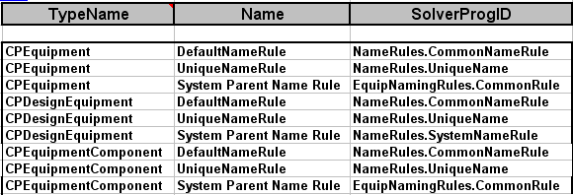
Naming Rules - Reference Data
Mapping of rules to object classes
Example: GenericNamingRules.xls
[Installation]\CatalogData\BulkLoad\Datafiles
Object Type Name in GUI VB Component ProgID

Slide 57
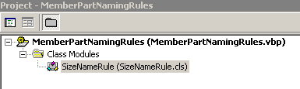
Naming Rules - Creation
Visual Basic component
Implements IJNameRule
ComputeName
  This method is used to format the name of an object
GetNamingParents
  This method is used to return the related parent object or objects that are used in forming a name
IJNameRule
NameRule
ComputeName()
GetNamingParents()
COM
Interface

Slide 58
Naming Rule Model
Object
Occurrences
IJNamedItem
IJDNameRuleHolder
Name
Rule Holder
NamedEntity
EntityNamingRule
IJNameRuleAE
Name Rule
Active Entity
Name
SolverProgID
NamingParents
NamingParents
IJDNameRule
COM Name Rule
Object
Occurrences
ComputeName()
AddNamingParents()
IJNamedItem
NameGenerator
Service
GetCount()
GentCountEx()
GetCountRange()
Object
Occurrences
IJNamedItem
Parent objects

Slide 59
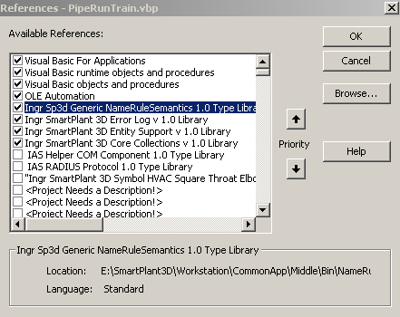
Naming Rules - Reference Libraries
  Ingr Sp3D Generic NameRuleSemantics 1.0 Type Library
  Ingr SmartPlant 3D Error Log v1.0 Library
  Ingr SmartPlant 3D Entity Support v 1.0 Library
  Ingr SmartPlant 3D Core Collections v 1.0 library

Slide 60
Naming Rules - Error Handling
When errors occur in retrieving properties or related objects,
proper error handling is important
  Use the middle tier error log to write specific information
    Dim oErrors as IJEditErrors ' middle tier errors
    Private Const E_FAIL = -2147467259
    …..
    Private Sub Class_Initialize()
    Set oErrors = new IMSErrorLog.JServerErrors
    End Sub
    ….
    On Error GoTo label
    label:
    oErrors.Add err.Number, Method, err.Description
    Err.Raise E_FAIL

Slide 61
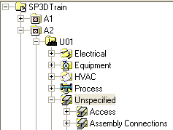
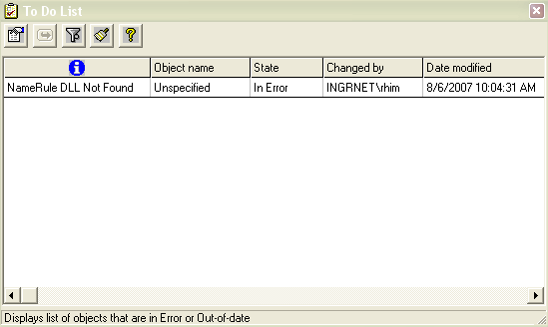
Naming Rules - Error Handling
If a name rule returns an error, the generic semantic will trap the error
  Set the name to “unspecified”
  Add the object to the To Do list

Slide 62
IJNameRule_ComputeName
This method is used to format the name of an object
  Private sub IJNameRule_ComputeName
  (
  ByVal oObject as object ‘ Object being named
  ByVal oParents as IJElements ‘ Naming Parents collection
  ByVal oActiveEntity as object ‘Naming rules active entity
  )

Slide 63
IJNameRule_ComputeName
Example:
Private Sub IJNameRule_ComputeName(ByVal oObject As Object, _
ByVal elements As IJElements, ByVal oActiveEntity As Object)
Dim oChildNamedItem As IJNamedItem
Dim strChildName As String
Set oChildNamedItem = oObject
……
‘Add code here to format the name….
……..
oChildNamedItem.Name = strChildName
Set oChildNamedItem = Nothing
Notes:
Dim oChildNamedItem As IJNamedItem
Dim strChildName As String
Set oChildNamedItem = oObject
strChildName = "MyName"
oChildNamedItem.Name = strChildName
Set oChildNamedItem = Nothi

Slide 64
Naming Rules - Services
Attribute Helper service
Relation Helper service
Naming counter service
GetNamingParents Method

Slide 65


Attribute Helper Service
Ingr SmartPlant 3D Attributes v 1.0 Library
Get Object attributes
Need to know the interface and property names.
Dim oAttributes As IJDAttributes
Set oAttributes = oObject
Dim strSeqNum As String
strSeqNum = oAttributes.CollectionOfAttributes("IJPipelineSystem").Item("SequenceNumber").Value
Notes:
Dim oAttributes As IJDAttributes
Set oAttributes = oObject
Dim strSeqNum As String
strSeqNum = oAttributes.CollectionOfAttributes("IJPipelineSystem").Item("SequenceNumber").Value

Slide 66
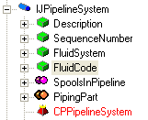
Attribute Helper Service
Dim FluidCodeID As Long
Dim strFluidCode As String
strFluidCode = vbNullString
Dim m_oCodeListMetadata As IJDCodeListMetaData
Set m_oCodeListMetadata = GetCatalogResourceManager
FluidCodeID = oAttributes.CollectionOfAttributes("IJPipelineSystem").Item("FluidCode").Value
strFluidCode = m_oCodeListMetadata.ShortStringValue("FluidCode", FluidCodeID)
strChildName = strFluidCode & "-" & strSeqNumber
oChildNamedItem.Name = strChildName
Set oChildNamedItem = Nothing
Set oAttributes = Nothing

Slide 67
Lab 10
Create a naming rule for Pipeline systems in the form:
Pipeline Name = Fluid Code + Sequence Number

Slide 68
Attribute Helper Service (Cont’s)
Example 1: Pipeline (Final code)
Dim oChildNamedItem As IJNamedItem
Dim strChildName As String
Set oChildNamedItem = oObject
strChildName = vbNullString
Dim oAttributes As IJDAttributes
Set oAttributes = oObject
Dim strSequenceNumber As String
strSequenceNumber = oAttributes.CollectionOfAttributes("IJPipelineSystem").Item("SequenceNumber").Value
Dim FluidCodeID As Long
Dim strFluidCode As String
strFluidCode = vbNullString
………

Slide 69
Attribute Helper Service (Cont’s)
…..
Set m_oCodeListMetadata = GetCatalogResourceManager
FluidCodeID = oAttributes.CollectionOfAttributes("IJPipelineSystem").Item("FluidCode").Value
strFluidCode = m_oCodeListMetadata.ShortStringValue("FluidCode", FluidCodeID)
strChildName = strFluidCode & "-" & strSequenceNumber
oChildNamedItem.Name = strChildName
Set oChildNamedItem = Nothing
Set oAttributes = Nothing
Notes:
Dim m_oCodeListMetadata As IJDCodeListMetaData
Private Sub IJNameRule_ComputeName(ByVal oObject As Object, ByVal elements As IJElements, ByVal oActiveEntity As Object)
Const METHOD = "IJNameRule_ComputeName"
On Error GoTo label
If oObject Is Nothing Then
Err.Raise vbInvalidArg, Module, METHOD
Exit Sub
End If
' Insert your Code
Dim oChildNamedItem As IJNamedItem
Dim strChildName As String
Set oChildNamedItem = oObject
strChildName = vbNullString
Dim oAttributes As IJDAttributes
Set oAttributes = oObject
Dim strSequenceNumber As String
strSequenceNumber = oAttributes.CollectionOfAttributes("IJPipelineSystem").Item("SequenceNumber").Value
Dim FluidCodeID As Long
Dim strFluidCode As String
strFluidCode = vbNullString
Set m_oCodeListMetadata = GetCatalogResourceManager
FluidCodeID = oAttributes.CollectionOfAttributes("IJPipelineSystem").Item("FluidCode").Value
strFluidCode = m_oCodeListMetadata.ShortStringValue("FluidCode", FluidCodeID)
strChildName = strFluidCode & "-" & strSequenceNumber
oChildNamedItem.Name = strChildName
Set oChildNamedItem = Nothing
Set oAttributes = Nothing
Exit Sub
label:
' log the error in middle tier and propagate the error code to the caller
m_oErrors.Add Err.Number, "IJNameRule_ComputeName", Err.Description
Err.Raise E_FAIL
End Sub

Slide 70
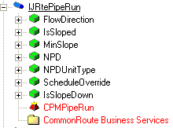
Attribute Helper Service
Example 2: PipeRun = NPD + NPD Units + Spec Name + Parent Pipeline System
Dim A as IJDAttributes
Set A = oObject
‘get the NPD of the current Run from the IJRtePipeRun interface
strNPD = A.CollectionOfAttributes(“IJRtePipeRun").Item(“NPD").Value

Slide 71

Attribute Helper Service (Cont’s)
Dim oChildNamedItem As IJNamedItem
Dim strChildName As String
Set oChildNamedItem = oObject
strChildName = vbNullString
Dim oAttributes As IJDAttributes
Set oAttributes = oObject
' Get NPD and Unit
Dim strNPD As String
Dim strNPDUnitType As String
strNPD = CStr(oAttributes.CollectionOfAttributes("IJRtePipeRun").Item("NPD").Value)
strNPDUnitType = oAttributes.CollectionOfAttributes("IJRtePipeRun").Item("NPDUnitType").Value

Slide 72
Attribute Helper Service (Cont’s)
If strNPDUnitType = "in" Then
strNPDUnitType = Chr(34)
End If
strChildName = strNPD & strNPDUnitType
oChildNamedItem.Name = strChildName
Set oChildNamedItem = Nothing
Set oAttributes = Nothing
Notes:
Private Sub IJNameRule_ComputeName(ByVal oObject As Object, ByVal elements As IJElements, ByVal oActiveEntity As Object)
Const METHOD = "IJNameRule_ComputeName"
On Error GoTo label
If oObject Is Nothing Then
Err.Raise vbInvalidArg, Module, METHOD
Exit Sub
End If
' Insert your Code
Dim oChildNamedItem As IJNamedItem
Dim strChildName As String
Set oChildNamedItem = oObject
strChildName = vbNullString
Dim oAttributes As IJDAttributes
Set oAttributes = oObject
' Get NPD and Unit
Dim strNPD As String
Dim strNPDUnitType As String
strNPD = CStr(oAttributes.CollectionOfAttributes("IJRtePipeRun").Item("NPD").Value)
strNPDUnitType = oAttributes.CollectionOfAttributes("IJRtePipeRun").Item("NPDUnitType").Value
If strNPDUnitType = "in" Then
strNPDUnitType = Chr(34)
End If
'Get specName
Dim oRelationHelper As IMSRelation.DRelationHelper
Dim oCollection As IMSRelation.DCollectionHelper
Set oRelationHelper = oObject
Dim oPipeSpec As IJDPipeSpec
Dim strSpecName As String
Set oCollection = oRelationHelper.CollectionRelations("IJRtePipeRun", "PipeSpecUsed")
Set oPipeSpec = oCollection.Item(1)
strSpecName = oPipeSpec.SpecName
'Get Parent
Dim oParentNamedItem As IJNamedItem
Dim strParentName As String
strParentName = vbNullString
Set oParentNamedItem = elements.Item(1)
strParentName = oParentNamedItem.Name
Set m_oCodeListMetadata = GetCatalogResourceManager
Dim HeatTracedID As Long
Dim strHeatTraced As String
strHeatTraced = vbNullString
HeatTracedID = oAttributes.CollectionOfAttributes("IJHeatTracingInfo").Item("HeatTracingRequirement").Value
strHeatTraced = m_oCodeListMetadata.ShortStringValue("HeatTracingRequirement", HeatTracedID)
Dim HeatMediumID As Long
Dim strHeatMedium As String
strHeatMedium = vbNullString
HeatMediumID = oAttributes.CollectionOfAttributes("IJHeatTracingInfo").Item("HeatTracingMedium").Value
strHeatMedium = m_oCodeListMetadata.ShortStringValue("HeatTracingMedium", HeatMediumID)
If HeatTracedID = 1 Or HeatTracedID = 0 Then
strChildName = strNPD & strNPDUnitType & "-" & strSpecName & "-" & strParentName
Else: strChildName = strNPD & strNPDUnitType & "-" & strSpecName & "-" & strParentName & "-" & strHeatMedium
End If
oActiveEntity.NamingParentsString = strChildName
oChildNamedItem.Name = strChildName
'Release BO's
Set oChildNamedItem = Nothing
Set oAttributes = Nothing
Set oRelationHelper = Nothing
Set oCollection = Nothing
Set oPipeSpec = Nothing
Set oParentNamedItem = Nothing
Exit Sub
label:
' log the error in middle tier and propagate the error code to the caller
m_oErrors.Add Err.Number, "IJNameRule_ComputeName", Err.Description
Err.Raise E_FAIL
End Sub

Slide 73
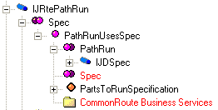
Relation Service
Ingr SmartPlant 3D Relation v 1.0 Library
Provides access to related objects
To use this service you must know the relation collection name and the interface name
Interface name: IJRtePathRun
Relation collection name: Spec
Relation Collection
Relation
Relation Collection

Slide 74

Relation Service (Cont’s)
Dim oRelationHelper As IMSRelation.DRelationHelper
Dim oCollection As IMSRelation.DCollectionHelper
Set oRelationHelper = oObject
Dim oSpec As IJDSpec
Dim strSpecName As String
Set oCollection = oRelationHelper.CollectionRelations("IJRtePathRun", "Spec")
Set oSpec = oCollection.Item(1)
strSpecName = oSpec.SpecName
Notes:
Private Sub IJNameRule_ComputeName(ByVal oObject As Object, ByVal elements As IJElements, ByVal oActiveEntity As Object)
Const METHOD = "IJNameRule_ComputeName"
On Error GoTo label
If oObject Is Nothing Then
Err.Raise vbInvalidArg, Module, METHOD
Exit Sub
End If
' Insert your Code
Dim oChildNamedItem As IJNamedItem
Dim strChildName As String
Set oChildNamedItem = oObject
strChildName = vbNullString
Dim oAttributes As IJDAttributes
Set oAttributes = oObject
' Get NPD and Unit
Dim strNPD As String
Dim strNPDUnitType As String
strNPD = CStr(oAttributes.CollectionOfAttributes("IJRtePipeRun").Item("NPD").Value)
strNPDUnitType = oAttributes.CollectionOfAttributes("IJRtePipeRun").Item("NPDUnitType").Value
If strNPDUnitType = "in" Then
strNPDUnitType = Chr(34)
End If
'Get specName
Dim oRelationHelper As IMSRelation.DRelationHelper
Dim oCollection As IMSRelation.DCollectionHelper
Set oRelationHelper = oObject
Dim oPipeSpec As IJDPipeSpec
Dim strSpecName As String
Set oCollection = oRelationHelper.CollectionRelations("IJRtePipeRun", "PipeSpecUsed")
Set oPipeSpec = oCollection.Item(1)
strSpecName = oPipeSpec.SpecName
'Get Parent
Dim oParentNamedItem As IJNamedItem
Dim strParentName As String
strParentName = vbNullString
Set oParentNamedItem = elements.Item(1)
strParentName = oParentNamedItem.Name
Set m_oCodeListMetadata = GetCatalogResourceManager
Dim HeatTracedID As Long
Dim strHeatTraced As String
strHeatTraced = vbNullString
HeatTracedID = oAttributes.CollectionOfAttributes("IJHeatTracingInfo").Item("HeatTracingRequirement").Value
strHeatTraced = m_oCodeListMetadata.ShortStringValue("HeatTracingRequirement", HeatTracedID)
Dim HeatMediumID As Long
Dim strHeatMedium As String
strHeatMedium = vbNullString
HeatMediumID = oAttributes.CollectionOfAttributes("IJHeatTracingInfo").Item("HeatTracingMedium").Value
strHeatMedium = m_oCodeListMetadata.ShortStringValue("HeatTracingMedium", HeatMediumID)
If HeatTracedID = 1 Or HeatTracedID = 0 Then
strChildName = strNPD & strNPDUnitType & "-" & strSpecName & "-" & strParentName
Else: strChildName = strNPD & strNPDUnitType & "-" & strSpecName & "-" & strParentName & "-" & strHeatMedium
End If
oActiveEntity.NamingParentsString = strChildName
oChildNamedItem.Name = strChildName
'Release BO's
Set oChildNamedItem = Nothing
Set oAttributes = Nothing
Set oRelationHelper = Nothing
Set oCollection = Nothing
Set oPipeSpec = Nothing
Set oParentNamedItem = Nothing
Exit Sub
label:
' log the error in middle tier and propagate the error code to the caller
m_oErrors.Add Err.Number, "IJNameRule_ComputeName", Err.Description
Err.Raise E_FAIL
End Sub

Slide 75
Relation Service (Cont’s)
oChildNamedItem.Name = strChildName & "-“ & strSpecName
Set oChildNamedItem = Nothing
Set oRelationHelper = Nothing
Set oCollection = Nothing
Set oPipeSpec = Nothing
Notes:
Private Sub IJNameRule_ComputeName(ByVal oObject As Object, ByVal elements As IJElements, ByVal oActiveEntity As Object)
Const METHOD = "IJNameRule_ComputeName"
On Error GoTo label
If oObject Is Nothing Then
Err.Raise vbInvalidArg, Module, METHOD
Exit Sub
End If
' Insert your Code
Dim oChildNamedItem As IJNamedItem
Dim strChildName As String
Set oChildNamedItem = oObject
strChildName = vbNullString
Dim oAttributes As IJDAttributes
Set oAttributes = oObject
' Get NPD and Unit
Dim strNPD As String
Dim strNPDUnitType As String
strNPD = CStr(oAttributes.CollectionOfAttributes("IJRtePipeRun").Item("NPD").Value)
strNPDUnitType = oAttributes.CollectionOfAttributes("IJRtePipeRun").Item("NPDUnitType").Value
If strNPDUnitType = "in" Then
strNPDUnitType = Chr(34)
End If
'Get specName
Dim oRelationHelper As IMSRelation.DRelationHelper
Dim oCollection As IMSRelation.DCollectionHelper
Set oRelationHelper = oObject
Dim oPipeSpec As IJDPipeSpec
Dim strSpecName As String
Set oCollection = oRelationHelper.CollectionRelations("IJRtePipeRun", "PipeSpecUsed")
Set oPipeSpec = oCollection.Item(1)
strSpecName = oPipeSpec.SpecName
'Get Parent
Dim oParentNamedItem As IJNamedItem
Dim strParentName As String
strParentName = vbNullString
Set oParentNamedItem = elements.Item(1)
strParentName = oParentNamedItem.Name
Set m_oCodeListMetadata = GetCatalogResourceManager
Dim HeatTracedID As Long
Dim strHeatTraced As String
strHeatTraced = vbNullString
HeatTracedID = oAttributes.CollectionOfAttributes("IJHeatTracingInfo").Item("HeatTracingRequirement").Value
strHeatTraced = m_oCodeListMetadata.ShortStringValue("HeatTracingRequirement", HeatTracedID)
Dim HeatMediumID As Long
Dim strHeatMedium As String
strHeatMedium = vbNullString
HeatMediumID = oAttributes.CollectionOfAttributes("IJHeatTracingInfo").Item("HeatTracingMedium").Value
strHeatMedium = m_oCodeListMetadata.ShortStringValue("HeatTracingMedium", HeatMediumID)
If HeatTracedID = 1 Or HeatTracedID = 0 Then
strChildName = strNPD & strNPDUnitType & "-" & strSpecName & "-" & strParentName
Else: strChildName = strNPD & strNPDUnitType & "-" & strSpecName & "-" & strParentName & "-" & strHeatMedium
End If
oActiveEntity.NamingParentsString = strChildName
oChildNamedItem.Name = strChildName
'Release BO's
Set oChildNamedItem = Nothing
Set oAttributes = Nothing
Set oRelationHelper = Nothing
Set oCollection = Nothing
Set oPipeSpec = Nothing
Set oParentNamedItem = Nothing
Exit Sub
label:
' log the error in middle tier and propagate the error code to the caller
m_oErrors.Add Err.Number, "IJNameRule_ComputeName", Err.Description
Err.Raise E_FAIL
End Sub

Slide 76
IJNameRule_GetNamingParents
This method is used to return the related parent object or objects that are used in forming a name
Private function IJNameRule_GetNamingParents
  (
  ByVal oEntity as object ‘ Object being named
  )
  As IJElements
All the Naming Parents that need to participate in an objects naming are added here to the IJElements collection.
Notes:
Private Function IJNameRule_GetNamingParents(ByVal oEntity As Object) As IJElements
Const METHOD = "IJNameRule_GetNamingParents"
On Error GoTo label
' Set IJNameRule_GetNamingParents = Nothing
' If you need the Parent objects, then Add code Here to get the Naming Parents that will participate in the naming.
Set IJNameRule_GetNamingParents = New IMSCoreCollections.JObjectCollection
Dim oSysChild As IJSystemChild
Set oSysChild = oEntity
Dim oSysParent As IJSystem
Set oSysParent = oSysChild.GetParent
If Not (oSysParent Is Nothing) Then
Call IJNameRule_GetNamingParents.Add(oSysParent)
End If
Set oSysChild = Nothing
Set oSysParent = Nothing
Exit Function
label:
' log the error in middle tier and propagate the error code to the caller
m_oErrors.Add Err.Number, "IJNameRule_GetNamingParents", Err.Description
Err.Raise E_FAIL
End Function

Slide 77
IJNameRule_GetNamingParents
Example:
Private Function IJNameRule_GetNamingParents(ByVal oEntity As Object) As IJElements
Const METHOD = "IJNameRule_GetNamingParents"
On Error GoTo label
Set IJNameRule_GetNamingParents = Nothing
' If you need the Parent objects, then Add code Here to get the Naming Parents that will participate in the naming.
‘Set IJNameRule_GetNamingParents = New IMSCoreCollections.JObjectCollection
Exit Function
label:
' log the error in middle tier and propagate the error code to the caller
m_oErrors.Add Err.Number, "IJNameRule_GetNamingParents", Err.Description
Err.Raise E_FAIL
End Function
Notes:
Private Function IJNameRule_GetNamingParents(ByVal oEntity As Object) As IJElements
Const METHOD = "IJNameRule_GetNamingParents"
On Error GoTo label
' Set IJNameRule_GetNamingParents = Nothing
' If you need the Parent objects, then Add code Here to get the Naming Parents that will participate in the naming.
Set IJNameRule_GetNamingParents = New IMSCoreCollections.JObjectCollection
Dim oSysChild As IJSystemChild
Set oSysChild = oEntity
Dim oSysParent As IJSystem
Set oSysParent = oSysChild.GetParent
If Not (oSysParent Is Nothing) Then
Call IJNameRule_GetNamingParents.Add(oSysParent)
End If
Set oSysChild = Nothing
Set oSysParent = Nothing
Exit Function
label:
' log the error in middle tier and propagate the error code to the caller
m_oErrors.Add Err.Number, "IJNameRule_GetNamingParents", Err.Description
Err.Raise E_FAIL
End Function

Slide 78
IJNameRule_GetNamingParents
Example (Return Parent Name)
Private Function IJNameRule_GetNamingParents(ByVal oEntity As Object) As IJElements
Const METHOD = "IJNameRule_GetNamingParents"
On Error GoTo label
Set IJNameRule_GetNamingParents = New IMSCoreCollections.JObjectCollection
Dim oSysChild As IJSystemChild
Set oSysChild = oEntity
Dim oSysParent As IJSystem
Set oSysParent = oSysChild.GetParent ‘an alternative is to navigate a relationship
If Not (oSysParent Is Nothing) Then
Call IJNameRule_GetNamingParents.Add(oSysParent)
End If
Set oSysChild = Nothing
Set oSysParent = Nothing
…….
Notes:
Private Function IJNameRule_GetNamingParents(ByVal oEntity As Object) As IJElements
Const METHOD = "IJNameRule_GetNamingParents"
On Error GoTo label
' Set IJNameRule_GetNamingParents = Nothing
' If you need the Parent objects, then Add code Here to get the Naming Parents that will participate in the naming.
Set IJNameRule_GetNamingParents = New IMSCoreCollections.JObjectCollection
Dim oSysChild As IJSystemChild
Set oSysChild = oEntity
Dim oSysParent As IJSystem
Set oSysParent = oSysChild.GetParent
If Not (oSysParent Is Nothing) Then
Call IJNameRule_GetNamingParents.Add(oSysParent)
End If
Set oSysChild = Nothing
Set oSysParent = Nothing
Exit Function
label:
' log the error in middle tier and propagate the error code to the caller
m_oErrors.Add Err.Number, "IJNameRule_GetNamingParents", Err.Description
Err.Raise E_FAIL
End Function

Slide 79

IJNameRule_ComputeName
'Get Parent
…….
Dim oParentNamedItem As IJNamedItem
Dim strParentName As String
strParentName = vbNullString
Set oParentNamedItem = elements.Item(1)
strParentName = oParentNamedItem.Name
oChildNamedItem.Name = strChildName & “-” & strParentName

Slide 80
IJNameRule_ComputeName
‘Code Snippet for getting all parents up to Unit System
Set IJNameRule_GetNamingParents = New IMSCoreCollections.JObjectCollection
Dim oSysChild As IJSystemChild
Dim oSysParent As IJSystem
' Build the collection of parents until a parent system is a Unit System
Set oSysChild = oEntity
Do
Set oSysParent = oSysChild.GetParent
Call IJNameRule_GetNamingParents.Add(oSysParent)
Set oSysChild = oSysParent
Loop Until TypeOf oSysParent Is IJUnitSystem

Slide 81
IJNameRule_GetNamingParents
Set IJNameRule_GetNamingParents = New IMSCoreCollections.JObjectCollection
Dim oSysChild As IJSystemChild
Dim oSysParent As IJSystem
' Build the collection of parent until the root.
Set oSysChild = oEntity
Do
Set oSysParent = oSysChild.GetParent
If Not TypeOf oSysParent Is IJConfigProjectRoot Then
Call IJNameRule_GetNamingParents.Add(oSysParent)
Set oSysChild = oSysParent
End If
Loop Until TypeOf oSysParent Is IJConfigProjectRoot
Set oSysChild = Nothing
Set oSysParent = Nothing

Slide 82
IJNameRule_ComputeName
Dim oParent As Object
Dim oParentNamedItem As IJNamedItem
Dim strParentName As String
If elements.Count > 0 Then
For Each oParent In elements
Set oParentNamedItem = oParent
strParentName = oParentNamedItem.Name
strChildName = strParentName + "-" + strChildName
Next oParent
oChildNamedItem.Name = strChildName
Else
Exit Sub
End If
Set oChildNamedItem = Nothing
Set oParentNamedItem = Nothing
Set oParent = Nothing

Slide 83
Lab 11
Create a naming rule for Pipe Runs as follows:
Pipe Run name = NPD + NPD Units + Spec Name + Parent System

Slide 84


Attribute Helper Service
Example 3: Member Part
Dim oAttributes As IJDAttributes
Set oAttributes = oObject
Dim MemberTypeID As Long
MemberTypeID = oAttributes.CollectionOfAttributes("ISPSMemberType").Item("TypeCategory").Value
Member Type Category Short Desc + Section Name + Location + IndexCounter

Slide 85

Attribute Helper Service
Dim strTableName As String
Dim strMemType As String
strTableName = "StructuralMemberTypeCategory“
Dim m_oCodeListMetadata As IJDCodeListMetaData
If m_oCodeListMetadata Is Nothing Then
Set m_oCodeListMetadata = GetCatalogResourceManager
End If
strMemType = UCase(m_oCodeListMetadata.ShortStringValue(strTableName,MemberTypeID))
Notes:
Dim m_oCodeListMetadata As IJDCodeListMetaData

Slide 86
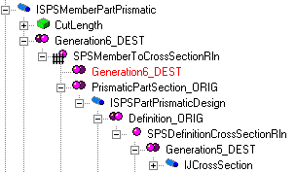
Relation Helper Service
Dim oRelationHelper As IMSRelation.DRelationHelper
Dim oCollectionHelper As IMSRelation.DCollectionHelper
Set oRelationHelper = oObject
Set oCollectionHelper = oRelationHelper.CollectionRelations("ISPSMemberPartPrismatic", "Generation6_DEST")
Set oRelationHelper = oCollectionHelper.Item(1)
Set oCollectionHelper = Nothing
Set oCollectionHelper = oRelationHelper.CollectionRelations("ISPSPartPrismaticDesign", "Definition_ORIG")
Dim oMembCrossSection As IJCrossSection
Set oMembCrossSection = oCollectionHelper.Item(1)

Slide 87
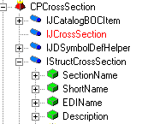
Attribute Helper Service
Dim strSectionName As String
Set oAttributes = oMembCrossSection
strSectionName =
oAttributes.CollectionOfAttributes("IStructCrossSection").Item("SectionName").Value

Slide 88
Naming Counter Service
  Sp3d NameGenerator 1.0 Type Library
  Naming counter service - generates a unique counter given a basis string
  GetCount(): This method returns a new index number if the basis string is different from the NamingParentString
  GetCountEx(): This method returns the count and the location prefix.
    Dim oNameCounter as IJNameCounter
    Set oNameCounter = New NameGeneratorService
    nCount = oNameCounter.GetCount(oModelResourceMgr, strBasis)
    Sname = strBasis + Str$(nCount)
    Or….
    nCount = oNameCounter.GetCountEx(oModelResourceMgr, strBasis, strLocation)
    Sname = strBasis + Str$(nCount)

Slide 89


Naming Service Architecture
SP3D (Taskhost.exe)
SP3DNameGenerator
COM+ Application On the Administrator machine
NameRule component (PipeRunLineID)
GetCount( pResourceManager, strBasename, * nCount )
NameGeneratorService
UpdateNumber

Slide 90
Naming Counter Service
Dim oNameCounter As IJNameCounter
Set oNameCounter = New GSCADNameGenerator.NameGeneratorService
Dim strLocation As String
strLocation = vbNullString
Dim nCount As Long
Set oModelResourceMgr = GetModelResourceManager
nCount = oNameCounter.GetCountEx(oModelResourceMgr, strChildName, strLocation)
If Not (strLocation = vbNullString) Then
strChildName = strChildName + "-" + strSectionName + "-" + strLocation + "-" +
CStr(nCount)
Else
strChildName = strChildName + "-" + strSectionName + "-" + CStr(nCount)
End If
oChildNamedItem.Name = strChildName

Slide 91
Naming Counter Service
  Sp3d NameGenerator 1.0 Type Library
  .
  GetCountRange(): This method specifies how many numbers should be reserved for the name basis when calling the name generator service. Currently, it hands out a range of 10 numbers to each incoming client.
    Dim oNameCounter as IJNameCounter
    Set oNameCounter = New NameGeneratorService
    nCount = oNameCounter.GetCountRange(oModelResourceMgr, strBasis, IDLocation, [UserRange = 10])
    Sname = strBasis + Str$(nCount)

Slide 92

Naming Counter Service
Name Generator Service
allocates 10 Numbers
001
002
003
…..
Client
allocates 10 Numbers
011
012
013
…..
Client
Call remote service
Client
allocates 10 Numbers
021
022
023
…..
Client
allocates 10 Numbers
031
032
033
…..

Slide 93
Binary Compatibility
A VB ActiveX DLL/OCX is a COM Class
  That is, it has a CLSID
When you build DLL, VB generates a new CLSID
Project that have your ActiveX DLL as a reference are then “broken”
  Reference is marked “Missing”
Solution: when you get a good build, save the DLL as a Binary-Compatible reference mark
  Make all future builds binary compatible to it
  This preserves the CLSID (& other project’s references!)

Slide 94

Naming Rules - Re-compute
Naming rule semantic is responsible for calling the ComputeName when the following actions occur:
  A property on the named object is modified.
  A property on the naming parent object is modified.
  System parent or assembly parent is changed.
Use the Update Name to re-fire the naming rule semantic to all objects in the select set

Slide 95
Lab 12
Create a naming rule for Member Parts such that:
Member Part name = Short Description of Member TypeCategory + Section Name + Location + IndexCounter

Slide 96
Interference Service - Overview
Two methods:
  Server (Database Detect)
    Run on a separate IFC machine as a windows service Look for all interferences for the entire model
    Production check
  Client (Local Detect)
    Local to a session (what you see in your workspace)
    Simple / dynamic
    Help the designer in real time
    No database record
LOCAL
APPLICATION
UPDATE
DESIGN
CHANGES
PERIODIC
QUERY
CHANGES
PERIODIC
REFRESH
DISPLAY
DATABASE
SERVER-BASED
RULES
Processing Rule
IJDInterferenceRule
UPDATE
RESULTS

Slide 97
Interference Service - Overview
Database Detect | Local Detect
Runs all the time (System Admin. choice) | Works only within the current session
Minimizes impact on users and improves performance | Provides immediate graphical feedback (works in a dynamic mode)
Creates persistent interferences that are stored in the model database | Shows interferences when the pointer is idle for a brief amount of time; based on a hesitation approach
Based on administrator settings (controlled by permission groups) | Based on individual user settings
Provides feed back on how much has been checked | Checks only created and modified items
Users can visualize the interferences (persistent items) | Clears dynamic interferences after refreshing workspace
© 2007. Intergraph Corporation. All Rights Reserved.

Slide 98

Interference Service - Overview
Three type of checking (based on the object aspects):
  Required (Hard)
  Optional (Soft)
  Not Checked
Can process:
  Required – Required (Hard – Hard)
  Required – Optional (Hard – Soft)
  Optional – Optional (Soft – Soft)
  SP3D - Foreign Interferences
A clearance can be used
© 2007. Intergraph Corporation. All Rights Reserved.

Slide 99
Interference Service - Overview
  Permission Requirements:
  Only an user who is Plant Administrator (Full Control on a plant) can start and stop IFC process
  Create a permission group where results will be assigned (IFC PG)
  Grant Write permission or higher to the Plant Administrator login on IFC PG
  Administrator should have at least Read permission in all other permission groups
  Configure the IFC Windows Service to utilize the Plant Administrator Login, e.g. domain\sp3dadmin. If possible use login with password not required to change as often as corporate users’
© 2007. Intergraph Corporation. All Rights Reserved.

Slide 100

Interference Service - Overview
  Interference objects:
  Any persistent interference detected by the Database Detect process appears as a sphere
  Interference detected by the Local Detect process appears as a box
Local Detect
Database Detect
© 2007. Intergraph Corporation. All Rights Reserved.

Slide 101
Interference Service - Overview
The system administrator sets up the background IFC settings at the beginning of the project including configuring the Windows Service.
If the system administrator want to change any settings for the background interference during the project execution, then all existing interferences will be deleted including any approvals and notes, and the background interference checking must be restarted. This ensures a recheck of all objects with the new settings for IFC.
© 2007. Intergraph Corporation. All Rights Reserved.

Slide 102



Service Settings
Interference Service - Overview
© 2007. Intergraph Corporation. All Rights Reserved.

Slide 103


Interference Service - Overview
© 2007. Intergraph Corporation. All Rights Reserved.

Slide 104

Interference Service - Overview
Interference Check is available in all Task (Tools → Check Interference)
Very simple and intuitive GUI
Ribbon bar includes:
  Settings
  Visualization
  Review & approval
© 2007. Intergraph Corporation. All Rights Reserved.

Slide 105

Interference Service - Overview
  Interference List Dialog Box
  - Resizable
  - Sort the listed interferences by Columns
  Highlight an interference in the workspace
  Double Click Interference entry to access property page for the interference
  Copy/Paste functionality from list to Excel
© 2007. Intergraph Corporation. All Rights Reserved.

Slide 106

IFC Entity Data Model
CPIfcEntity
Package
Class
Interface

Slide 107

IFC Entity Data Model
Generic Object interfaces
IJDObject interface is a required interface for almost all objects. This interface provides access to the permission group for the object, the status, name of the user who created and last modified the object and the date and time for creation and last modification.
Class
Interface
Property

Slide 108

IFC Entity Data Model
Generic Object interfaces
IJNamedItem interface provides the name property and a type string for all named objects. This interface is used by any component that needs the name of an object as well as by components that need to display a simple type string for an object.

Slide 109

IFC Entity Data Model
Geometry interfaces
IJGeometry interface is required if the BO has geometry
IJGraphicEntity interface is required if the BO is displayable

Slide 110

IJFoulCheck
IJFoulCheck is the basic interface used by Interference Engine to determine if the object implementing it collides with other objects that implement it.

Slide 111

IFC Entity Data Model
Interference Interface
IJIfcEntity interface keeps track of all the interference properties created by the object.
Property
Codelist

Slide 112

IFC Entity Data Model
Interference Relationship
BO’s implement the IJFoulCheck interface which is used to identify which objects should be checked for interferences with other object.
IJFoulCheck has a relation with the actual interference object's interface.

Slide 113


IFC Entity Data Model
Interference Relationship

Slide 114

IFC Entity Data Model
Example: List all persistent interferences created by equipment objects
Select x1.FoulType as Type, x2.ItemName as IFCName,
x3.RelationName as Part, x5.ItemName as EqpName
from JIfcEntity x1
JOIN JNamedItem x2 on x2.oid = x1.oid
JOIN XInterference x3 on x3.oidorigin = x1.oid
JOIN JEquipment x4 on x4.oid = x3.oidDestination
JOIN JNamedItem x5 on x5.oid = x4.oid
Notes:
Select x1.FoulType as Type,
x2.ItemName as IFCName,
x3.RelationName as Part,
x5.ItemName as Name
from JIfcEntity x1
JOIN JNamedItem x2 on x2.oid = x1.oid
JOIN XInterference x3 on x3.oidorigin = x1.oid
JOIN SPSSlabEntity x4 on x4.oid = x3.oidDestination
JOIN JNamedItem x5 on x5.oid = x4.oid

Slide 115


Interference Processing Rule
Customized component that allows users to define rules that automatically set properties on the Interference objects during creation and modification or to decide whether the Interference objects need to be persisted in the Database.

Slide 116
Interference Processing Rule
The Interference Processing rule is a Visual Basic component
Implements
- IJDInterferencePrePrcsrRule
- IJDInterferenceRule
Processing:
  Call at Creation - Create Interference method
  Call at Modification of existing interference - Modify Interference method
  Aspect Control - Get valid physical representation method
ProcessorRule
ProcessObject()
CreateInterference()
ModifyInterference()
GetValidPhysicalRepresentation()
COM
Interface

Slide 117


Interference Processing Rule
The Interference processing rule program is located at
<Install Directory>\Programming\ExampleCode\Rules\InterferenceRules

Slide 118

Interference Processing Rule
Processor Rule Module includes:
Private Sub Class_Initialize()
Private Sub Class_Terminate()
Function IJDInterferencePrePrcsrRule_ProcessObject()
Function IJDInterferenceRule_CreateInterference()
Sub IJDInterferenceRule_ModifyInterference()
Function IJDInterferenceRule_GetValidPhysicalRepresentation()

Slide 119
Interference Pre Processing Rule
Pre Processor Rule Module
This Rule will be called by interference service after it updates the range of the object. The object under processing and the Object type are sent as arguments and this rule returns True or False value. Based on this the object is either ignored or considered further.
Private Function IJDInterferencePrePrcsrRule_ProcessObject(ByVal pObject As Object, ByVal strObjectType As String) As Boolean
On Error GoTo ErrorHandler
IJDInterferencePrePrcsrRule_ProcessObject = True
‘ Insert your code
Exit Function
ErrorHandler:
Err.Clear
IJDInterferencePrePrcsrRule_ProcessObject = True
End Function

Slide 120
Interference Pre Processing Rule
Example:
Private Function IJDInterferencePrePrcsrRule_ProcessObject(ByVal pObject As Object, ByVal strObjectType As String) As Boolean
On Error GoTo ErrorHandler
IJDInterferencePrePrcsrRule_ProcessObject = True
‘Ignore objects based on the ObjectType.
If strObjectType Like "Plate System" Then
IJDInterferencePrePrcsrRule_ProcessObject = False
End If
Exit Function
ErrorHandler:
Err.Clear
IJDInterferencePrePrcsrRule_ProcessObject = True
End Function

Slide 121

Interference Pre Processing Rule
Example:
Ignore objects based on their range extents

Slide 122

Interference Pre Processing Rule
Example:
Ignore objects based on their range extents

Slide 123
Interference Post Processing Rule
Processor Rule Module includes:
Four example rules:
Suppress interference between objects imported from CIMSteel
Assign a proper permission group for the interference object based on the colliding object’s ranking
Assign proper status for the interference object based on the interference type
Don’t report Insulation and insulation interferences when 2 pipes are connected by a component
Additional routines to support the example rules
  Private Sub AssignIFCPermissionGroup()
  Private Function GetPermissionGroupIndex()
  Private Function IsConnectedbyIntermediate()
  Private Function ConvertPGNameToNumber()
  Private Function GetAspectName()
  Private Function GetAspectCode()
  Private Function Distance()
  Private Function GetObjectIdentifyer()
  Private Function AreBothImportedObjects()
  Private Function GetResourceManager()

Slide 124
Interference Post Processing Rule
Create Interference method
This method gets triggered just after Interference process detects an Interference and just before persisting the same to the Database.
  Decide whether the Interference should be persisted or not in the Database.
  Initialize the interference properties automatically
    Permission Group
    Remarks
    Status (Action Required)

Slide 125
Processing Rule - Creation
Create Interference method
Example Rule 1: Suppress interference between objects imported from CIMSteel or from Tribon
If (AreBothImportedObjects(pParent1, pParent2)) Then
IJDInterferenceRule_CreateInterference = False
Exit Function
End If
pParent1[in] First Parent participating in Collision
pParent2[in] Second Parent participating in Collision
Imported Tribon objects support "IJImportedStructureItem"and "IJDImpPlate" interface
Imported CIMSteel (CIS/2) objects support “IJStructEDIData” interface
Tribon is a shipbuilding CAD/CAM program

Slide 126
Processing Rule - Creation
Create Interference method
Example Rule 2: Assign a proper permission group for the interference object based on the colliding object’s ranking.
If IfcType = IfcServerInterference Then
AssignIFCPermissionGroup pInterferenceObj, strParentType1, strParentType2
End If
pInterferenceObj[in] Pointer to IJIfcEntity
strParentType1[in] Type of first Parent participating in Collision
strParentType2[in] Type of second Parent participating in Collision

Slide 127
Processing Rule - Creation
Rule 2 (Example)
GroupIndex=0 Supports or Routes or Eqp objects
GroupIndex=1 Structure objects
GroupIndex=2 Interference Volumes
"IFC Group1“ Equipment & Piping users
"IFC Group2“ Structure users
"IFC Group3“ Interference volume users
When an interference happens with 2 different objects, Interference is recorded in the lowest rank (GroupIndex) of interfering objects. Therefore people who are in charge of the same will correct them accordingly.

Slide 128
Processing Rule - Creation
Rule 2 (Example)
Class_Initialize()
ReDim m_strPermissionGroups(3) As String
m_strPermissionGroups(0) = "IFC Group1“ (Supports + Routes + Eqp objects)
m_strPermissionGroups(1) = "IFC Group2“ (Structure objects)
m_strPermissionGroups(2) = "IFC Group3“ (Interference Volumes)

Slide 129
Processing Rule - Creation
Function GetPermissionGroupIndex()
Select Case (strParentType)
Case "Pipe Supports", "Cable Tray Supports", "Duct Supports"
GetPermissionGroupIndex = 0
Case "Conduits“, "Cable Tray Components", "Cableway Straight", "Cable Trays",
"Pipes", "Piping Welds", "Piping Components", "Piping Instruments", _
"Piping Specialty Items“, "Equipment“, "Cableway Turn“, "Cableway Along Leg“, _
"HVAC Components", "Ducts"
GetPermissionGroupIndex = 0
Case "Member Part Linear", "Slab", "Footing", "Stairs", "Ladders", "Handrails“ _
"Member Part Curve", "Equipment Foundation"
GetPermissionGroupIndex = 1
Case "Interference Volumes"
GetPermissionGroupIndex = 2
Case Default GetPermissionGroupIndex = -1
End Select

Slide 130
Processing Rule - Creation
Private Sub AssignIFCPermissionGroup(ByVal pNewInterference As IJIfcEntity,
ByVal strParentType1 As String, ByVal , strParentType2 As String)
PGIndexObj1 = GetPermissionGroupIndex(strParentType1)
PGIndexObj2 = GetPermissionGroupIndex(strParentType2)
If PGIndexObj1 < PGIndexObj2 Then
strInterferencePG = m_strPermissionGroups(PGIndexObj1)
Else
strInterferencePG = m_strPermissionGroups(PGIndexObj2)
End If
Set pObject = pNewInterference
nPGNumber = ConvertPGNameToNumber(strInterferencePG)
pObject.PermissionGroup = nPGNumber
Set pObject = Nothing

Slide 131

Processing Rule - Creation
Rule 2(Example)
Equipment collides with Member Part Prismatic

Slide 132

Processing Rule - Creation
Create Interference method
Example Rule 3: Assign proper status for the interference object based on the interference type.
If IfcType = IfcServerInterference Then
If pInterferenceObj.InterferenceType = ftSevereFoul Then
pInterferenceObj.InterferenceStatus = fsUnacceptableFoul
ElseIf pInterferenceObj.InterferenceType = ftOptionalFoul Then
pInterferenceObj.InterferenceStatus = fsUndefinedFoul
ElseIf pInterferenceObj.InterferenceType = ftClearanceFoul Then
pInterferenceObj.InterferenceStatus = fsAcceptableFoul
Else 'It is a Bad part foul
pInterferenceObj.InterferenceStatus = fsUnacceptableFoul
End If
End If

Slide 133

Processing Rule - Creation
Rule 3 (Example)

Slide 134
Processing Rule - Modification
Modification Interference method
Rule 1: Default implementation just resetting the status and add a note.
Dim strAppendNotes As String
Dim strexistingNotes As String
strAppendNotes = " Changes did not remove the Interference"
If IfcType = IfcServerInterference Then
Select Case (pOldInterference.InterferenceType)
Case ftSevereFoul
pOldInterference.InterferenceStatus = fsUnacceptableFoul
Case ftOptionalFoul
pOldInterference.InterferenceStatus = fsUndefinedFoul
Case ftClearanceFoul
pOldInterference.InterferenceStatus = fsAcceptableFoul
Case ftBadPartFoul
pOldInterference.InterferenceStatus = fsUndefinedFoul
End Select
If Not (strAppendNotes Like "") Then
strexistingNotes = pOldInterference.InterferenceRemark
strexistingNotes = strexistingNotes + strAppendNotes
pOldInterference.InterferenceRemark = strexistingNotes
End If
End If

Slide 135

Processing Rule - Creation
Training Example
Add notes for the interference object based on the object type
Dim strNotes As String
strNotes = ""
If IfcType = IfcServerInterference Then
If strParentType1 Like "Member Part Linear" And _
strParentType2 Like "Member Part Linear" Then
strNotes = "Call Structure Design leader"
pInterferenceObj.InterferenceRemark = strNotes
End If
End If
Notes:
'------------------------------Set remark property -------------------------------------------------------------------
Dim strNotes As String
strNotes = ""
If IfcType = IfcServerInterference Then
If strParentType1 Like "Member Part Prismatic" And _
strParentType2 Like "Member Part Prismatic" Then
strNotes = "Call Structure Design leader"
End If
If Not (strNotes Like "") Then
pInterferenceObj.InterferenceRemark = strNotes
End If
End If

Slide 136
Processing Rule - Creation
Training Example
Don’t report handrails-to-slab collisions
If IfcType = IfcServerInterference Then
If HandrailClashGrating(strParentType1, strParentType2, pParent1, pParent2) Then
IJDInterferenceRule_CreateInterference = False
Exit Function
End If
End If
Notes:
'--------------- Do not create Interference object when both colliding objects are slabs -----------------------------
If IfcType = IfcServerInterference Then
If strParentType1 Like "Slabs" And strParentType2 Like "Slabs" Then
IJDInterferenceRule_CreateInterference = False
Exit Function
End If
End If

Slide 137
Processing Rule - Creation
The algorithm of this rule is as follows:
When ObjectType1 = “Slab” and ObjectType2 = “HandRail”
Get the slab type using the relation service
Get the part number of the slab using the attribute service
If InStr(slabtype,”Grating”) is true
Then, create the interference
When ObjectType1 = “Handrail” and ObjectType2 = “Slab”
Get the slab type using the relation service
Get the part number of the slab using the attribute service
If InStr(slabtype,”Grating”) is true
Then, create the interference
Notes:
Private Function IsNipconnectedtoInsPipe(ByVal Obj1 As Object, _
ByVal Obj2 As Object) As Boolean
On Error GoTo ErrorHandler
IsNipconnectedtoInsPipe = False
Dim oRelationHelper As IMSRelation.DRelationHelper
Dim oCollection As IMSRelation.DCollectionHelper
Set oRelationHelper = Obj1
Dim oRelatedObject As IJDPipeComponent
Set oCollection = oRelationHelper.CollectionRelations("IJPartOcc", "Part")
Set oRelatedObject = oCollection.Item(1)
Dim oAttributes As IJDAttributes
Set oAttributes = oRelatedObject
Dim iCommodityType As Long
iCommodityType = _
oAttributes.CollectionOfAttributes("IJDPipeComponent").Item("CommodityType").Value
If iCommodityType = 1105 Then
If IsConnectedbyIntermediate(Obj1, Obj2) = True Then
IsNipconnectedtoInsPipe = True
End If
End If
Set oRelationHelper = Nothing
Set oCollection = Nothing
Set oRelatedObject = Nothing
Set oAttributes = Nothing
Exit Function
ErrorHandler:
Debug.Assert False
Set oRelationHelper = Nothing
Set oCollection = Nothing
Set oRelatedObject = Nothing
Set oAttributes = Nothing
End Function

Slide 138

Processing Rule - Creation
Relationship
The following picture shows an example. This defines a relationship of type SlabEntityReferenceRln between the interface ISPSSlabEntity, origin of the relationship, and the interface IJDPart for a destination.
  The interface origin of the relationship
  The interface destination of the relationship
  A relationship type
Use the relation helper to access the part of the colliding object
Use the Attribute Helper to get the part number of the slab
Notes:
Private Function IsNipconnectedtoInsPipe(ByVal Obj1 As Object, _
ByVal Obj2 As Object) As Boolean
On Error GoTo ErrorHandler
IsNipconnectedtoInsPipe = False
Dim oRelationHelper As IMSRelation.DRelationHelper
Dim oCollection As IMSRelation.DCollectionHelper
Set oRelationHelper = Obj1
Dim oRelatedObject As IJDPipeComponent
Set oCollection = oRelationHelper.CollectionRelations("IJPartOcc", "Part")
Set oRelatedObject = oCollection.Item(1)
Dim oAttributes As IJDAttributes
Set oAttributes = oRelatedObject
Dim iCommodityType As Long
iCommodityType = _
oAttributes.CollectionOfAttributes("IJDPipeComponent").Item("CommodityType").Value
If iCommodityType = 1105 Then
If IsConnectedbyIntermediate(Obj1, Obj2) = True Then
IsNipconnectedtoInsPipe = True
End If
End If
Set oRelationHelper = Nothing
Set oCollection = Nothing
Set oRelatedObject = Nothing
Set oAttributes = Nothing
Exit Function
ErrorHandler:
Debug.Assert False
Set oRelationHelper = Nothing
Set oCollection = Nothing
Set oRelatedObject = Nothing
Set oAttributes = Nothing
End Function

Slide 139
Processing Rule - Creation
Relation Helper
CollectionRelations(interfaceID, collectionName As String) As Object
Set oRelationHelper = Obj1
Dim oAttrbs As IJDAttributes
Set oCollection = oRelationHelper.CollectionRelations("ISPSSlabEntity",“SlabEntityTypeReferenceRln_ORIG")
Set oAttrbs = oCollection.Item(1)
slabtype = oAttrbs.CollectionOfAttributes("IJDPart").Item("PartNumber").Value
Obj1
Interface
Relation Collection
Related Object
Notes:
Private Function IsNipconnectedtoInsPipe(ByVal Obj1 As Object, _
ByVal Obj2 As Object) As Boolean
On Error GoTo ErrorHandler
IsNipconnectedtoInsPipe = False
Dim oRelationHelper As IMSRelation.DRelationHelper
Dim oCollection As IMSRelation.DCollectionHelper
Set oRelationHelper = Obj1
Dim oRelatedObject As IJDPipeComponent
Set oCollection = oRelationHelper.CollectionRelations("IJPartOcc", "Part")
Set oRelatedObject = oCollection.Item(1)
Dim oAttributes As IJDAttributes
Set oAttributes = oRelatedObject
Dim iCommodityType As Long
iCommodityType = _
oAttributes.CollectionOfAttributes("IJDPipeComponent").Item("CommodityType").Value
If iCommodityType = 1105 Then
If IsConnectedbyIntermediate(Obj1, Obj2) = True Then
IsNipconnectedtoInsPipe = True
End If
End If
Set oRelationHelper = Nothing
Set oCollection = Nothing
Set oRelatedObject = Nothing
Set oAttributes = Nothing
Exit Function
ErrorHandler:
Debug.Assert False
Set oRelationHelper = Nothing
Set oCollection = Nothing
Set oRelatedObject = Nothing
Set oAttributes = Nothing
End Function

Slide 140
Processing Rule - Creation
Training Example
Don’t report interferences when colliding objects belong to a Test Permission Group
If IfcType = IfcServerInterference Then
If objectBelongToPG("TESTPG", pParent1, pParent2) Then
IJDInterferenceRule_CreateInterference = False
Exit Function
End If
End If
Notes:
' Exclude colliding objects that belongs to a permission group like Test Permission Group
' This rule will allow user to place preliminary objects so that the interference process will not
' persisted any interference objects.
If IfcType = IfcServerInterference Then
If IfParentBelongtoTestPG(pParent1, pParent2) Then
IJDInterferenceRule_CreateInterference = False
End If
End If

Slide 141
Processing Rule - Creation
objectBelongToPG()
Private Function objectBelongToPG(UPPERCASE_pgName_substring As String _
, ByVal pParent1 As Object _
, ByVal pParent2 As Object _
) As Boolean
On Error GoTo ErrHndlr
objectBelongToPG = False
Dim pNum1 As Long, pNum2 As Long
Dim strPgName1 As String, strPgName2 As String
Dim pObject1 As IJDObject
Dim pObject2 As IJDObject
Set pObject1 = pParent1
Set pObject2 = pParent2
pNum1 = pObject1.PermissionGroup
pNum2 = pObject2.PermissionGroup
strPgName1 = ConvertPGNumberToName(pNum1)
strPgName2 = ConvertPGNumberToName(pNum2)
If InStr(UCase(strPgName1), UPPERCASE_pgName_substring) > 0 Or _
InStr(UCase(strPgName2), UPPERCASE_pgName_substring) > 0 Then
objectBelongToPG = True
Exit Function
End If
Notes:
Private Function IfParentBelongtoTestPG(ByVal pParent1 As Object, _
ByVal pParent2 As Object) As Boolean
On Error GoTo ErrHndlr
IfParentBelongtoTestPG = False
Dim pNum1, pNum2 As Long
Dim strPgName1, strPgName2 As String
Dim pObject1 As IJDObject
Dim pObject2 As IJDObject
Set pObject1 = pParent1
Set pObject2 = pParent2
pNum1 = pObject1.PermissionGroup
pNum2 = pObject2.PermissionGroup
strPgName1 = ConvertPGNumberToName(pNum1)
strPgName2 = ConvertPGNumberToName(pNum2)
If strPgName1 Like "Test Permission Group" Or _
strPgName2 Like "Test Permission Group" Then
IfParentBelongtoTestPG = True
Exit Function
End If
Set pObject1 = Nothing
Set pObject2 = Nothing
Exit Function
ErrHndlr:
Debug.Assert False
Set pObject1 = Nothing
Set pObject2 = Nothing
End Function

Slide 142
Processing Rule - Creation
ConvertPGNumberToName()
Private Function ConvertPGNumberToName(ByVal PGnum As Long) As String
On Error GoTo ErrHndlr
Dim PGID, count As Long
Dim pgName As String
Dim i As Long
Dim oMidCtx As IJMiddleContext
Dim oDBTypeConfig As IJDBTypeConfiguration
Dim oDataBaseConfig As IJDataBaseConfiguration
Dim oACConfig As IJAccessControlConfiguration
Dim oAccessControl As IJAccessControl
ConvertPGNumberToName = "“
Set oDBTypeConfig = New DBTypeConfiguration
Set oDataBaseConfig = New DataBaseConfiguration
Set oACConfig = New AccessControlConfiguration
Set oMidCtx = New GSCADMiddleContext
oMidCtx.GetConfigurationTablesFromMiddle oDBTypeConfig, oDataBaseConfig, oACConfig
Set oAccessControl = oACConfig.AccessControl
count = oACConfig.NumberConditionIDs
For i = 1 To count
oACConfig.GetConditionIDByIndex i, pgName, PGID
If PGID = PGnum Then
ConvertPGNumberToName = pgName
Exit Function
End If
Next i
Notes:
Private Function IfParentBelongtoTestPG(ByVal pParent1 As Object, _
ByVal pParent2 As Object) As Boolean
On Error GoTo ErrHndlr
IfParentBelongtoTestPG = False
Dim pNum1, pNum2 As Long
Dim strPgName1, strPgName2 As String
Dim pObject1 As IJDObject
Dim pObject2 As IJDObject
Set pObject1 = pParent1
Set pObject2 = pParent2
pNum1 = pObject1.PermissionGroup
pNum2 = pObject2.PermissionGroup
strPgName1 = ConvertPGNumberToName(pNum1)
strPgName2 = ConvertPGNumberToName(pNum2)
If strPgName1 Like "Test Permission Group" Or _
strPgName2 Like "Test Permission Group" Then
IfParentBelongtoTestPG = True
Exit Function
End If
Set pObject1 = Nothing
Set pObject2 = Nothing
Exit Function
ErrHndlr:
Debug.Assert False
Set pObject1 = Nothing
Set pObject2 = Nothing
End Function

Slide 143

Processing Rule - Creation
Create Interference method
Example Rule 4: Don’t report Insulation and insulation interferences when 2 pipes are connected by a component.
When ObjectType1 = “Pipe part”
If Aspect1 = Aspect2 = Insulation. Then do the following logic
otherwise break and create an Interference.
Get connected Objects for Object1. --- List1.
For each object in List1
Get Connected objects, -- List2
For each Object in List2
If Object is Object 2 then
Both objects are connected through a middle object.
Break the loop
Endif
Loop for next object in List 2
Loop for next object in List 1
If the Objects are not connected through an intermediate object then
create the interference otherwise not.

Slide 144
Processing Rule - Creation
Rule 4 (Example)
If (strParentType1 <> strParentType2) Then
Exit Function
Else
If Not (strParentType1 Like "Pipes") Then
Exit Function
End If
If pInterferenceObj.InterferenceAspectA = pInterferenceObj.InterferenceAspectB Then
If GetAspectName(pInterferenceObj.InterferenceAspectA) Like "Insulation" Then
If IsConnectedbyIntermediate(pParent1, pParent2) = True Then
IJDInterferenceRule_CreateInterference = False
Exit Function
Else IJDInterferenceRule_CreateInterference = True
Exit Function
End If
End If
End If
End If

Slide 145
Processing Rule - Modification
Modification Interference method
  This rule gets triggered when Interference detection process is trying to modify an interference, because of the modification of the parts participating in the collision.
  Decide what to do when the parent(s) of an existing interference have been modified. Example:
    Change status
    Add Notes

Slide 146
Interference Post processing Rule
Get Valid Physical Representation Rule method
  If Interference process finds an object which has 2 physical representations, this rule will choose the proper representation to be used for that type of object.
Private Function IJDInterferenceRule_GetValidPhysicalRepresentation(ByVal strObjectType As String, ByVal SupportedPhysicalReps As Long) As Long
On Error GoTo ErrorHandler
'Kept a check for Pipe Supports as Detailed physical aspect Geometry is not good.
If ((strObjectType Like "Pipe Supports") Or (strObjectType Like "Duct Supports") Or (strObjectType Like "Cable Tray Supports")) Then
IJDInterferenceRule_GetValidPhysicalRepresentation = GetAspectCode("Simple physical")
Else
IJDInterferenceRule_GetValidPhysicalRepresentation = GetAspectCode("Detailed physical")
End If
Exit Function

Slide 147
Lab 13-16
Lab 13 Create Interference Check Post-Processing Rule.
Lab 14 Interference object remark property
Lab 15 Interference rule for Handrails-to-Slab collisions
Lab 16 Interference Rule for objects belonging to a Test Permission Group

